Slide 1
Spotify Music Recommender
Vab Guglani and Alex Swenson
Northeastern University
DS 4300

Slide 2
What is it?
We created a song recommender based on Vab’s Music library
It analyzes song features to output similar songs with similar features

Slide 3
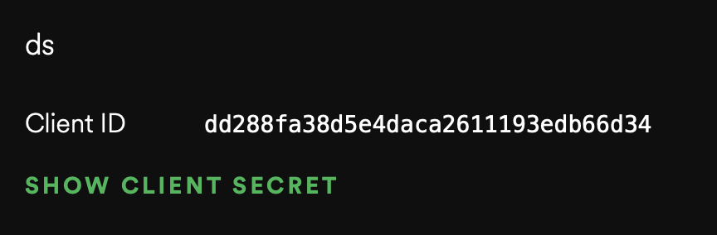
Data Acquisition and Cleaning
Using Spotipy and our own client we were able to scrape data from spotify includinig song features, album tracks, and similar tracks
We had to make a spotify developer account to acquire credentials, as seen below

Slide 4
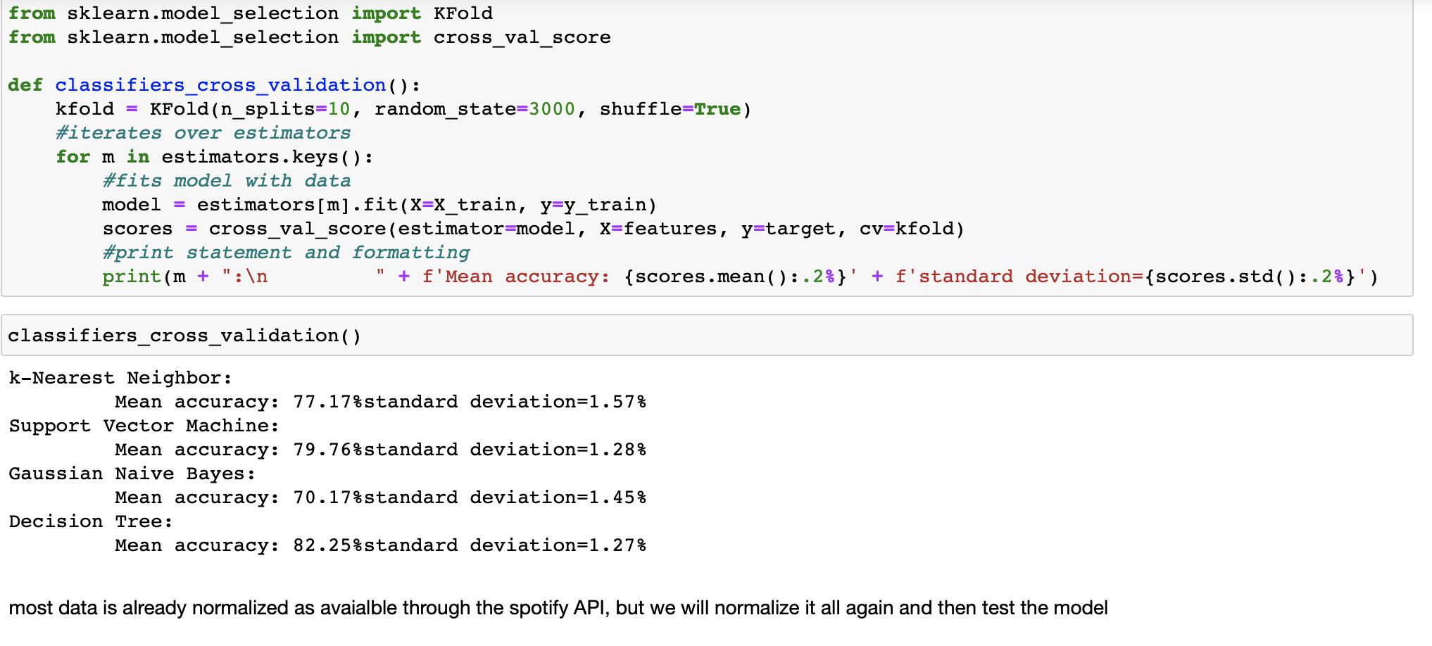
Machine Learning
We used several ML algorithms suuch as KNN, SVM, and decison tree
Our results are below

Slide 5
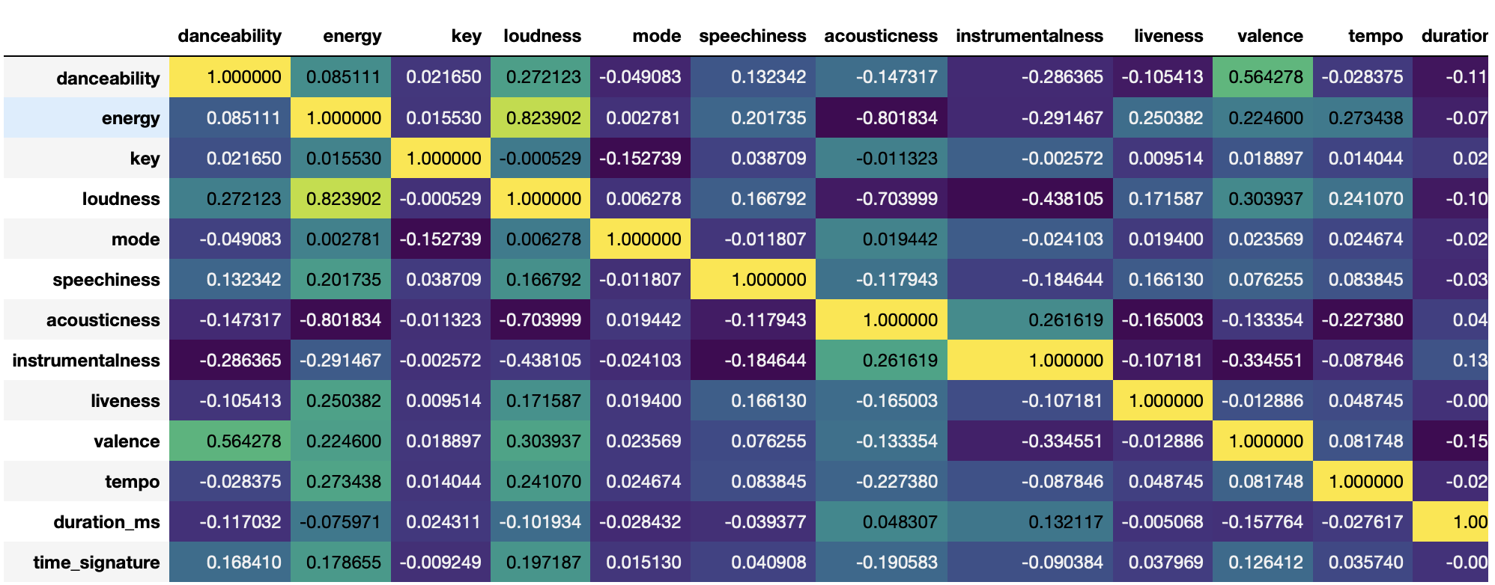
Machine Learning Ctd.
Heatmap showing correlation between song features

Slide 6
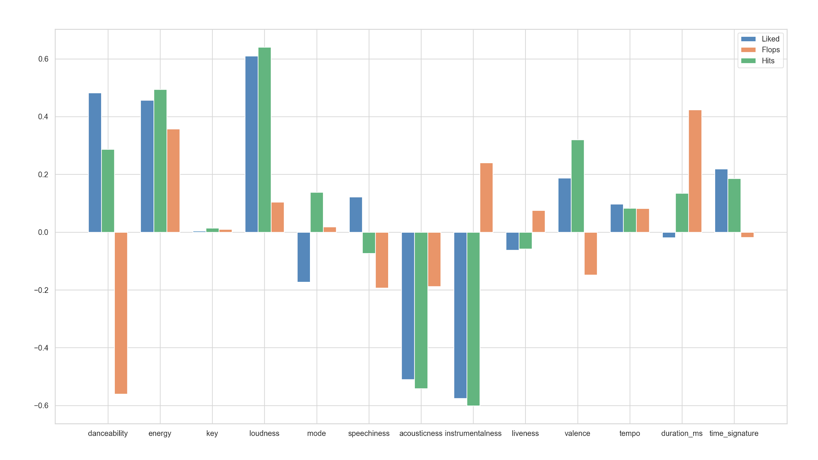
Further Graphs
Vab’s library compared to hits, and flops, 0 is the standard for the average song

Slide 7
Further Work
Make available for all users
Use playback and social media data to make recommendations more personal

